Slide 1
Goetz Phase 2 - Biome Shift Project
Mapping and Modeling Attributes of an Arctic – Boreal Biome Shift within the ABoVE domain
Adrianna Foster Northern Arizona University, Flagstaff AZ
Matt Macander ABR Inc. – Environmental Research, Fairbanks, AK
Michelle Mack Northern Arizona University, Flagstaff AZ
Peter Nelson University of Maine, Fort Kent ME
Brendan Rogers Woods Hole Research Center, Falmouth MA
Collaborators National Park Service, Fish & Wildlife Service,
Canadian Forest Service, POLAR Canada, NW Boreal LCC
Major Objectives / Efforts
Map plant functional type changes, including lichen, across the Arctic portion of the ABoVE domain
Assess forest productivity and mortality changes across the Boreal portion of the domain
Spatially model boreal tree species productivity, mortality and biomass across the domain
Work with land management agency collaborators to inform management priorities
Adrianna Foster Northern Arizona University, Flagstaff AZ
Matt Macander ABR Inc. – Environmental Research, Fairbanks, AK
Michelle Mack Northern Arizona University, Flagstaff AZ
Peter Nelson University of Maine, Fort Kent ME
Brendan Rogers Woods Hole Research Center, Falmouth MA
Collaborators National Park Service, Fish & Wildlife Service,
Canadian Forest Service, POLAR Canada, NW Boreal LCC

Slide 2
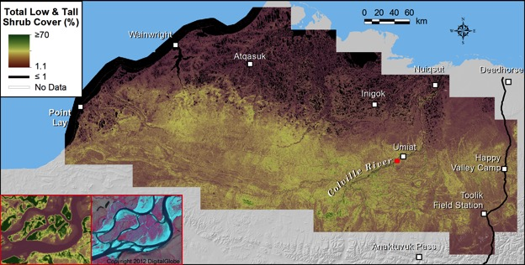
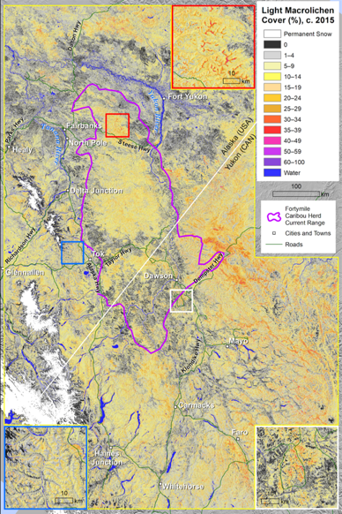
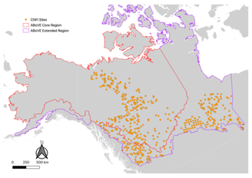
Arctic: Major Phase 1 results: Plant Functional Type maps across the Arctic portion of the domain
Major Phase 1 results: Lichen cover map of interior Alaska and the Yukon
(incl. Forty Mile Caribou Herd range)
Macander et al. (2017), Regional Quantitative Cover Mapping of Tundra Plant Functional Types in Arctic Alaska, Remote Sensing
Macander et al.>>> (forthcoming), Lichen cover mapping across caribou ranges of interior Alaska and the Yukon,
ERL Focus Collection

Slide 3
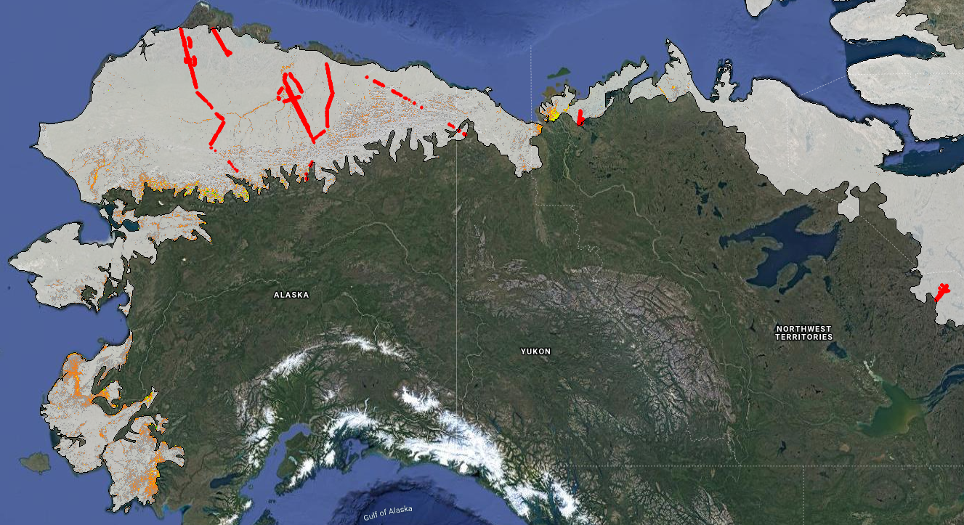
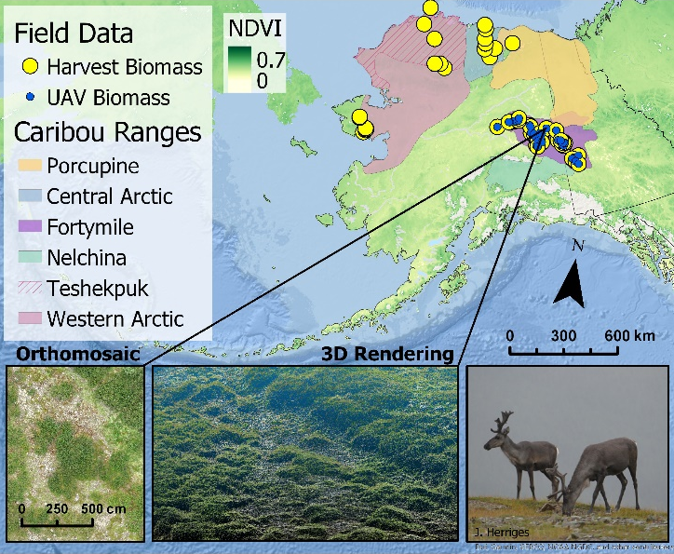
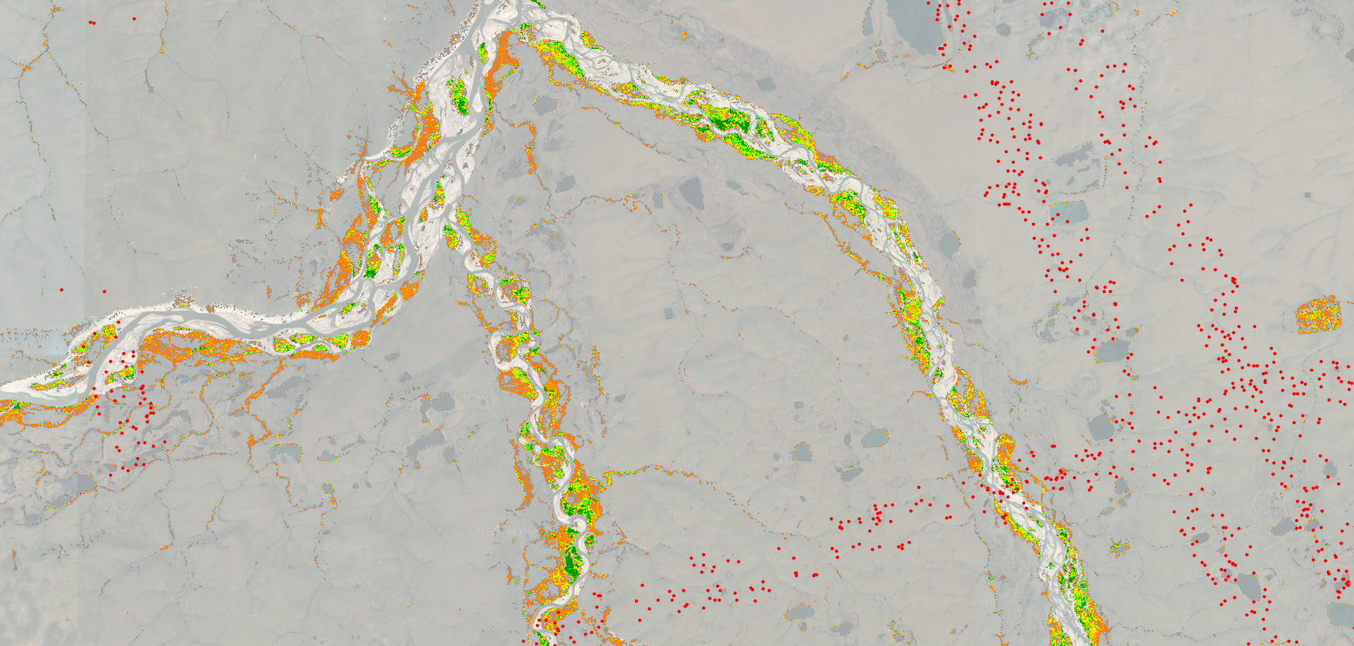
Arctic - Transitioning into Phase 2: Expanding to entire Arctic portion of the ABoVE domain
%LVIS Return
≥50cm
2 15
Preliminary map of tundra shrub cover (> 50 cm height) trained exclusively using LVIS data (red lines).
Predictors include growing season QC-masked Landsat imagery from 2013–2018.
Map extent is clipped to clipped to CAVM subzones D and E.

Slide 4
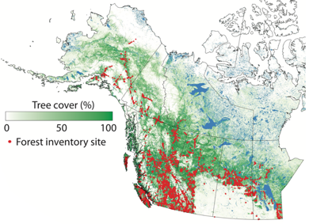
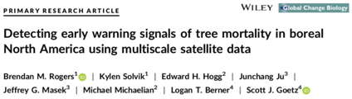
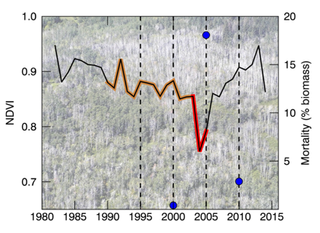
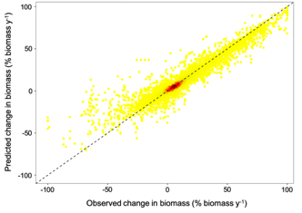
Boreal: Using multi-decadal satellite time series to detect changing forest demographics
Major Phase 1 finding: Early warning signals of tree mortality can be detected using multi-decadal NDVI
Transitioning into Phase 2: Predictive modeling of forest demographics using satellite imagery
Thousands of repeatedly-measured inventory plots provide data on changing demographics
Declining vigor
High mortality
Preliminary predictive models of changing forest
biomass.
Early warning signals of tree mortality to capture negative changes
(Rogers et al. 2018 GCB)
Inciting stress

Slide 5
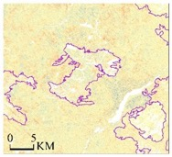
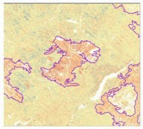
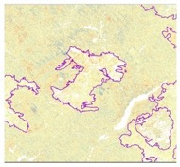
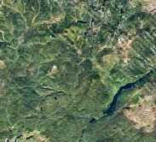
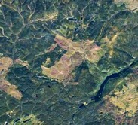
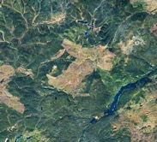
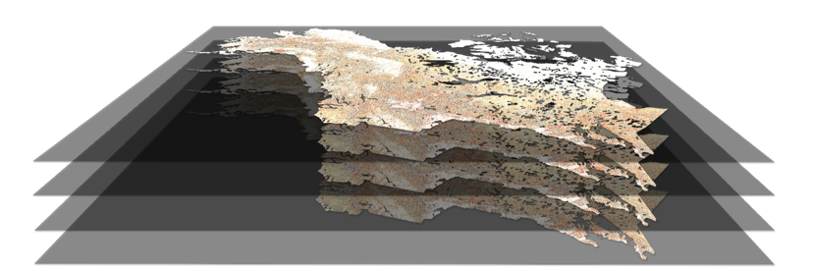
Boreal: Drivers of deciduous fraction cover change
2000-2005
2005-2010
2010-2015
+50
N
DF change
Disturbance types:
  Fire
  Harvest
  Insects
  Drought mortality?
-50
126°30’W 60°22N
Google Earth Engine High-res Image
SPOT, 2005
WorldView-2, 2010
WorldView-2, 2014
Massey et al. forthcoming
Jointly with Rogers et al.
affiliated CCS projecct
2015 - 2010
2010 - 2005
2005 - 2000
2000 - 1990

Slide 6
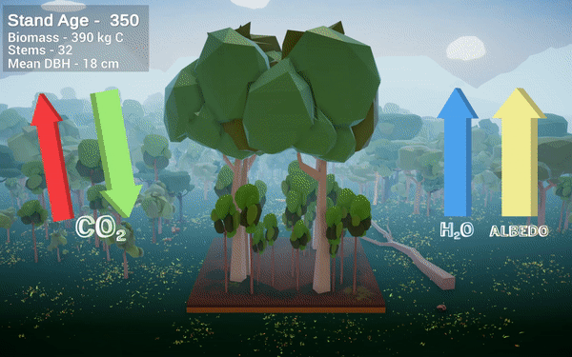
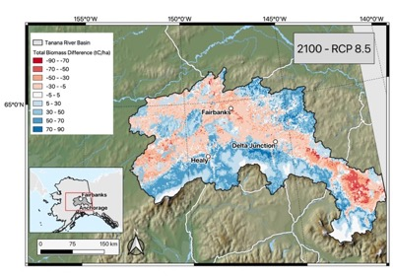
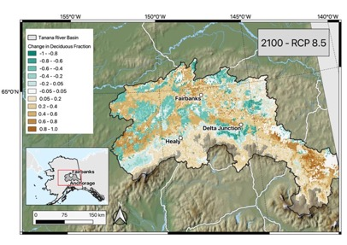
Boreal modeling: Using individual tree-based modeling to predict forest change
Major Phase 1 finding: Decreasing biomass and increasing deciduous fraction in interior AK under climate change scenarios
Climate change
Climate change
birch
white spruce
white spruce
aspen
black spruce
aspen
Foster et al. 2019, Ecological Modelling, forthcoming
See Adrianna’s poster

Slide 7
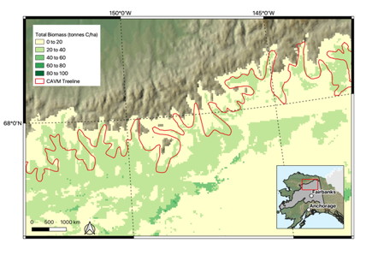
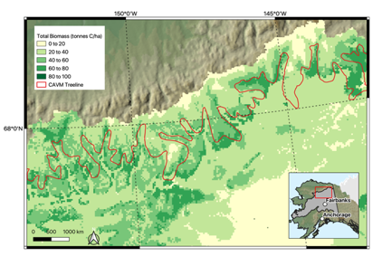
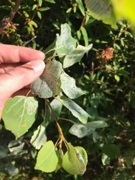
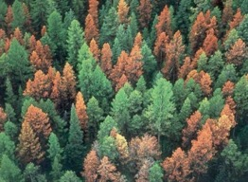
Major Phase 1 finding (2): Increasing biomass at northern range boundaries
Transitioning into Phase 2: Expanding to entire ABoVE domain, incorporation of insect infestation
Year 2011
Calibration data sets
Can-NFI & PSP data, others
Tree-ring chronologies
Decid. Fraction maps
aspen leaf miner
Year 2100
Use remote sensing and field data to refine existing insect infestation submodels
spruce beetle
See you at the posters!
Foster et al. GCB, forthcoming

